Slide 1
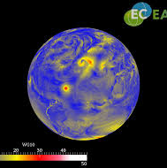



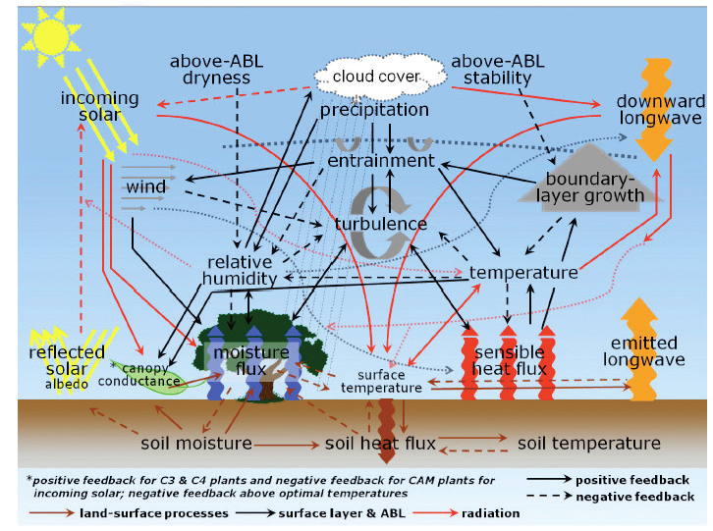
Preliminary experiences with the EC-Earth single column model for DICE
Reinder Ronda and Bert Holtslag
DICE/GABLS workshop, Exeter, October 14-16, 2013

Slide 2
EC-Earth model strategy (Courtesy Wilco Hazeleger)
Use leading weather prediction model: European Centre for Medium-Range Weather Forecasts (ECMWF) Forecast System
…and build into Earth System prediction system
Bridge the gap between weather forecasting and climate projections (‘seamless’)
Continuous development/updates
Share resources & data with national and international partners
→ (Re)forecasts, projections, science questions

Slide 3

EC-Earth consortium
Steering group: W. Hazeleger (KNMI, chair), C. Jones (SMHI), J. Hesselbjerg, Christensen (DMI), R. McGrath (Met Eireann), P. Viterbo (IM), E. C. Rodriguez (AEMET), A. Provenzale (CNR) observer E. Kallen (ECMWF), NEMO-representative
The Netherlands
KNMI, U Utrecht, WUR, VU. SARA
Ireland
MetEireann, UCD, ICHEC
Denmark
DMI, Univ Copenh
Switzerland
ETHZ, C2SM
Portugal
IM, U Lisbon
Spain
AEMET, BSC, IC3
Norway
NTNU, Bjerkn. C.
Sweden
SMHI, Lund U, Stockholm U, IRV
Belgium
UCL
Italy
ICTP,CNR, ENEA
Germany
IFM/GEOMAR

Slide 4
EC-Earth v3.0 model
Atmosphere: ECMWF SFS 4: IFS cycle36r4 (physics only)
Ocean: NEMO V3 (physics only)
Sea ice: LIM2 Louvain la Neuve ice model
Land: H-TESSEL
Coupler: OASIS3
L91 vertical layers
Usually run on T_{L} 255 horizontal resolution

Slide 5
EC-Earth Single Column Model (SCM)
Atmosphere: ECMWF SFS 4: IFS cycle36r4 (physics only)
Ocean: NEMO V3 (physics only)
Sea ice: LIM2 Louvain la Neuve ice model
Land: H-TESSEL
Coupler: OASIS3
L91 vertical layers
Usually run on T_{L} 255 horizontal resolution

Slide 6
3 experiments
Uncoupled (uc): prescribed surface fluxes (stage 1)
Coupled (co): with climatological LAI (~1.5)
LAI=0.15: with reduced LAI (~0.15)
Soil moisture and soil temperature provide by a spinup run using H-TESSEL (IFS cy37r3)

Slide 7
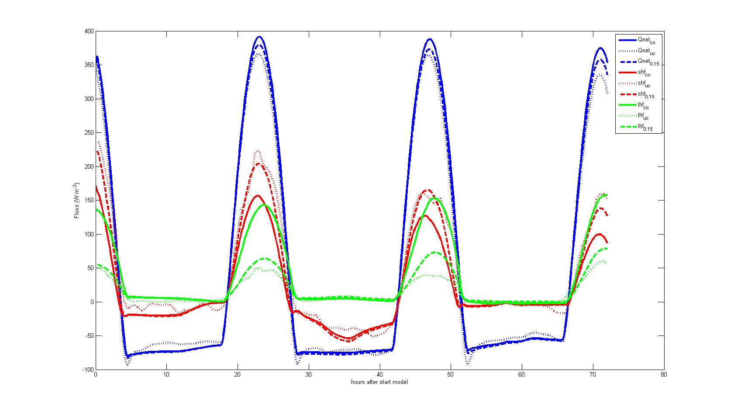
Results 1: surface energy budget
Reference Coupled run overestimates latent heat flux strongly
Reducing LAI to 0.15 improves latent heat flux considerably (Larry Mahrt: “grass is dead”)

Slide 8
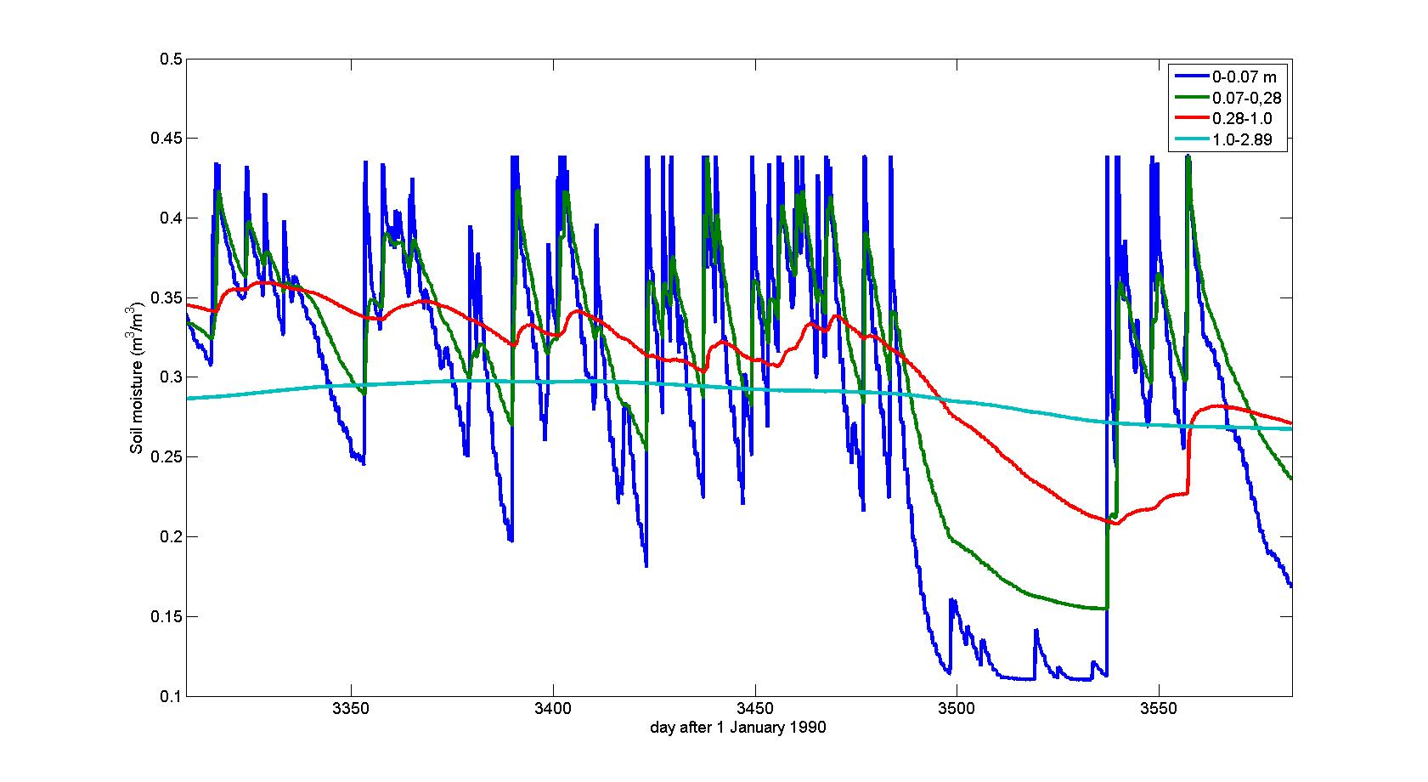
soil moisture in spin-up run Does soil respond to fast to atmospheric controls?
Soil moisture reservoir refilled because of september rains
Soil moisture well above wilting point
Wilting point
Prolonged drought during summer 1999

Slide 9
Hypothesis
In reality:
Prolonged dry period during summer of 1999
Root soil moisture approaches wilting point
Dying of grass
No regeneration of grass
in wet September/October
Low LAI and thus low evapotranspiration during CASES99
In Model:
Prolonged dry period during summer of 1999
Root soil moisture approaches wilting point
Reduction of evapotranspiration
(Partial) refill of root zone soil
moisture during wet September
High climatological LAI and evapotranspiration during CASES99

Slide 10
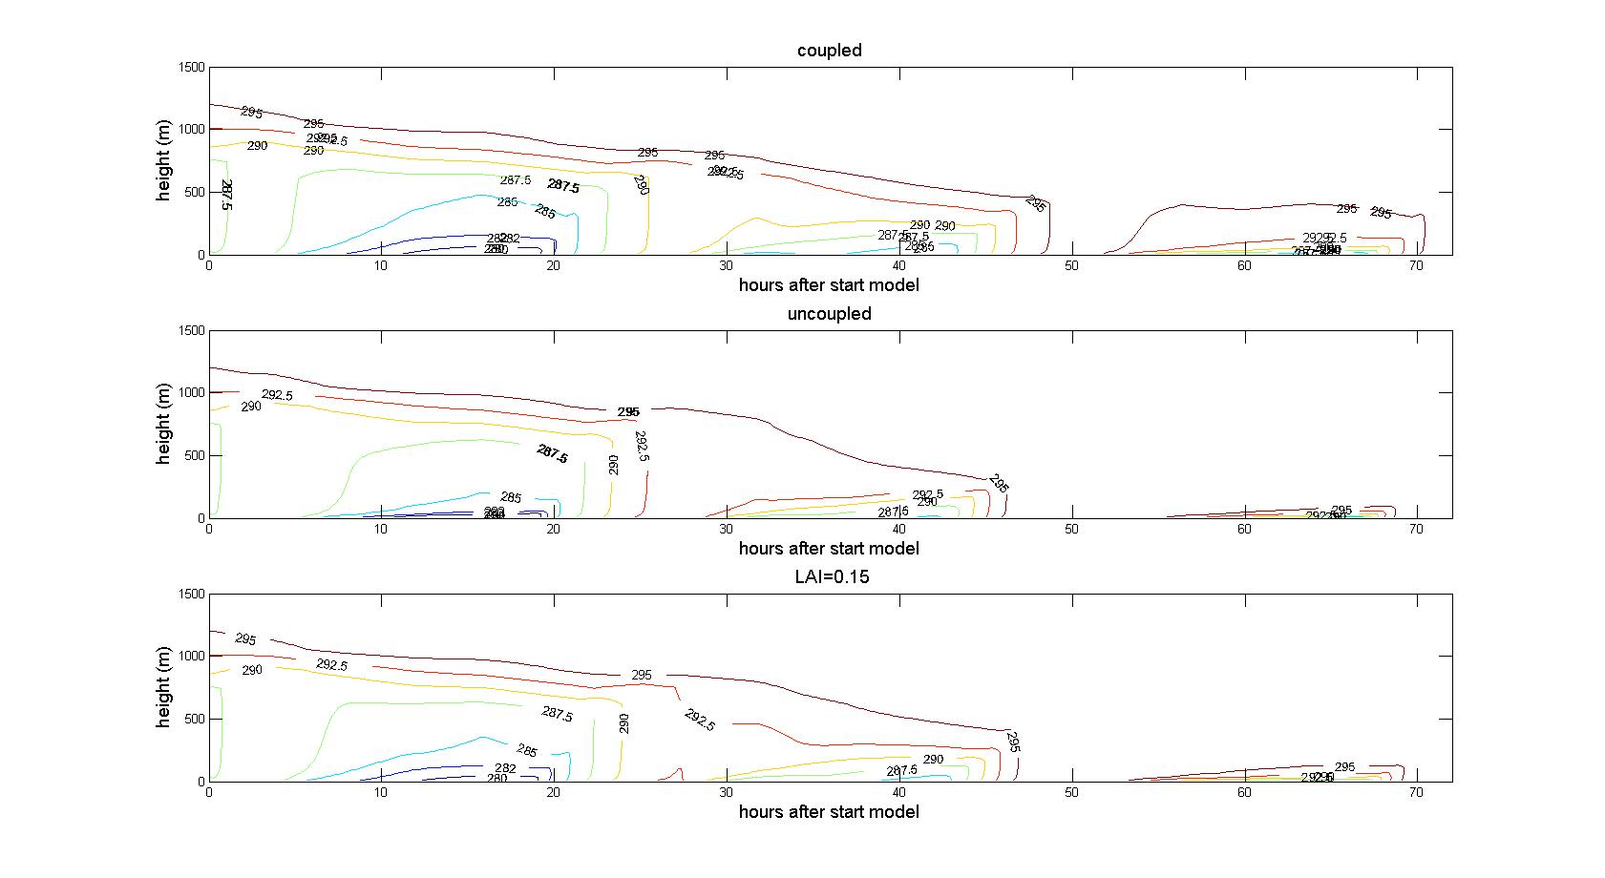
Results 2: Profiles of potential temperature
The coupled run (climatological LAI) leads to relatively cool CBLs
The uncoupled run and the LAI=0.15 run give somewhat warmer CBLs

Slide 11
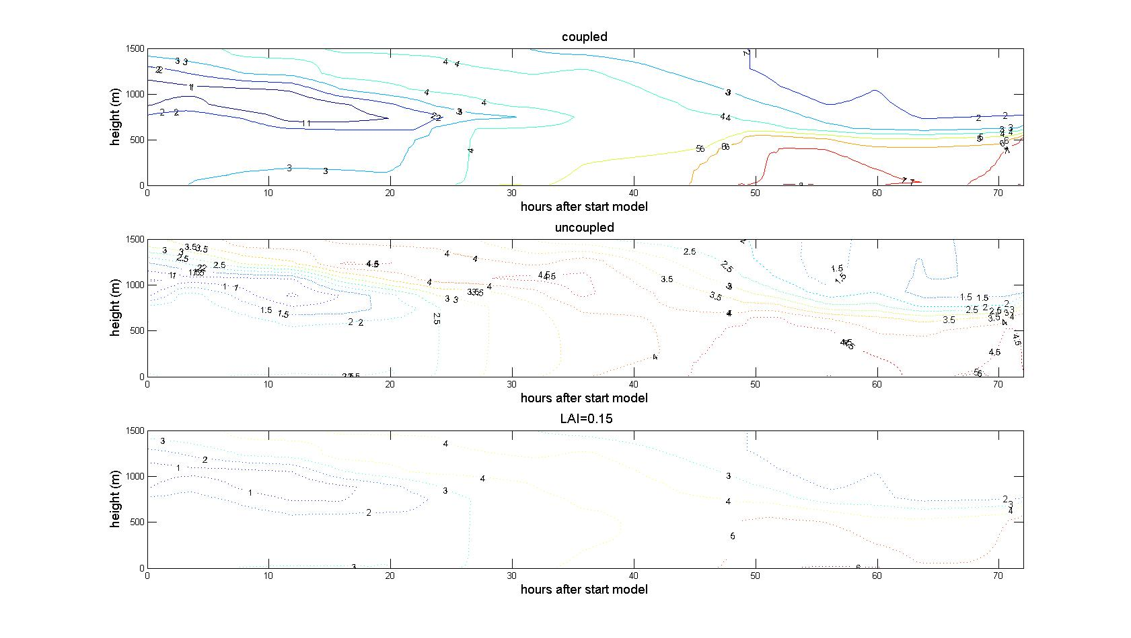
Results 3: Profiles of specific humidity
The coupled run (climatological LAI) leads to a relatively moist CBLs
The uncoupled run and the LAI=0.15 run give somewhat dryer CBLs

Slide 12
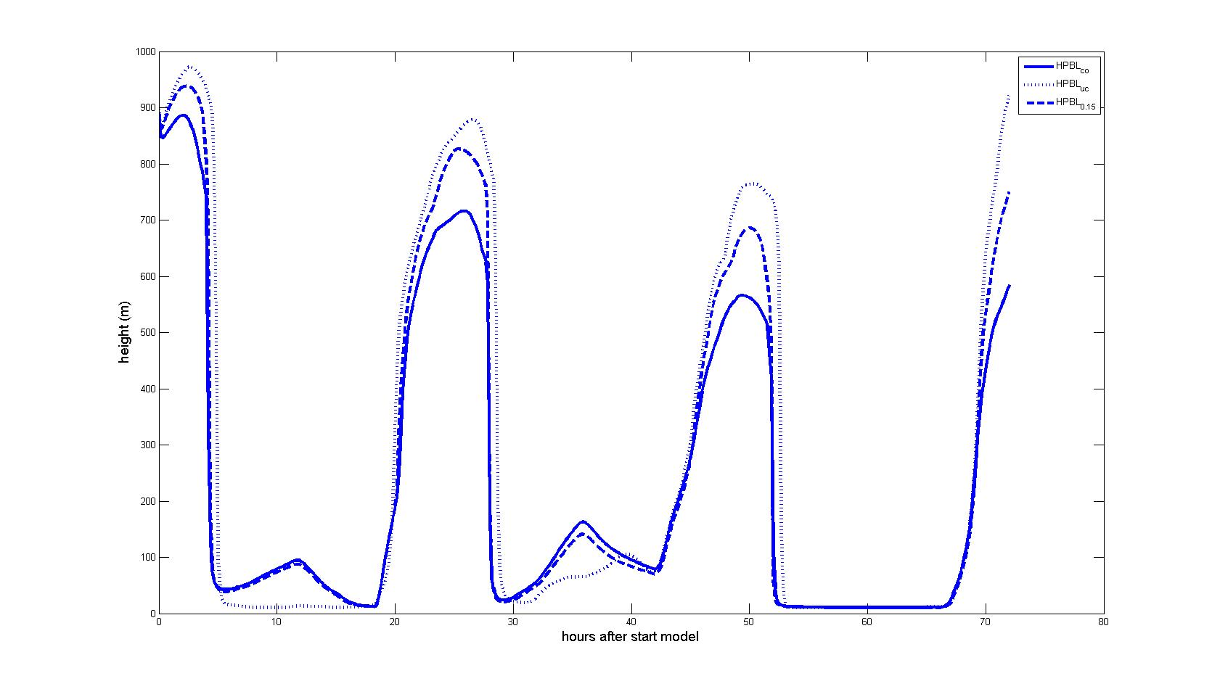
Results 4: evolution of PBL
The coupled run (climatological LAI) leads to shallow CBLs
The uncoupled run and the LAI=0.15 run give somewhat higher CBLs

Slide 13
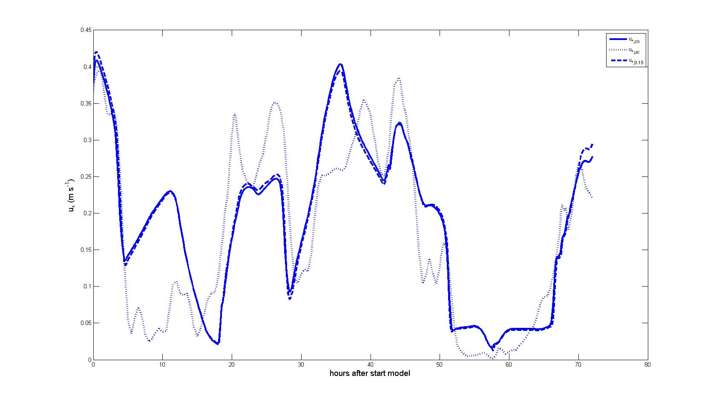
Results 4: evolution of PBL
The coupled run (climatological LAI) and the LAI=0.15 run give
Similar values of the friction velocity that are rather close to the prescribed values in the uncoupled run

Slide 14
Conclusion
“Standard” EC-Earth-SCM in coupled mode overestimates LHF during CASES99
Possibly this is due to climatological value of LAI which is too high (the dying of grass)
High LHF for coupled run leads to relatively shallow, cold and moist CBLSs
Bias in LHF can be reduced by decreasing LAI to 0.15 (climatological value is 1.5)
Effect on friction velocity is less pronounced

Slide 15
Thank you!

Slide 16

7th International Scientific Conference on the Global Energy and Water Cycle
World Forum
The Hague, The Netherlands 14-17 July 2014

Slide 17
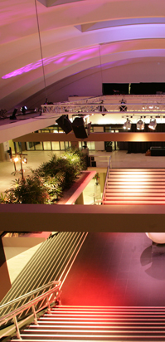
7th International Scientific Conference on the Global Energy and Water Cycle
Conference format will be similar to the 2011 WCRP
Open Science Conference
Plenary with speakers
(including Land-Atmosphere Interaction Session)
Poster sessions
Call for papers soon, see www.gewex.org
The Conference will be followed by Pan-GEWEX and Pan-CLIVAR Meetings

